Slide 1

TITLE

Slide 2
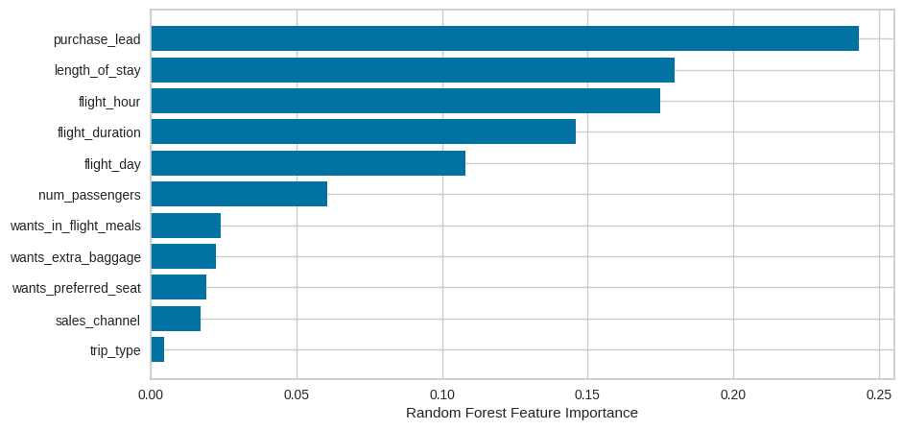
ACCURACY
62%
Top features that drives successful flight booking.
The ACCURACY of the model predicting successful or incomplete bookings correctly.
PRECISION
61%
This will be predicted as actually completed bookings out of all successfully completed bookings.
Imbalance dataset drives accuracy higher to 83% but does not accurately predict successful bookings

